Slide 1
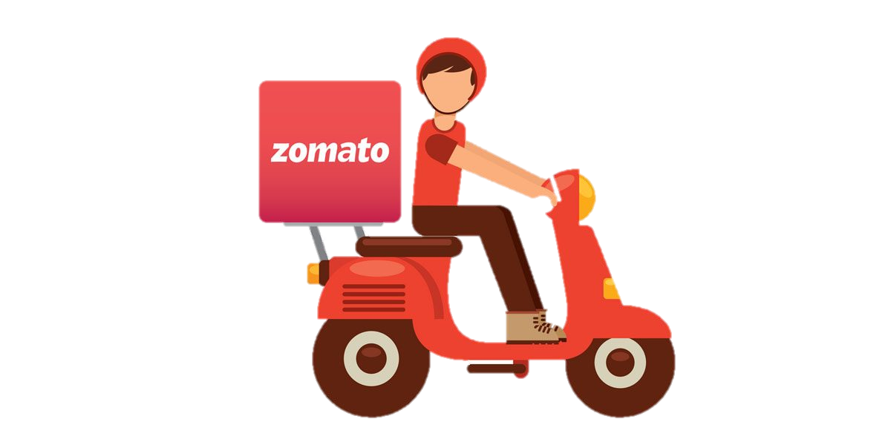
ZOMATO ANALYSIS
By Group 4

Slide 2

Business Overview
Zomato, a popular restaurant discovery and food delivery platform, offers a treasure trove of data that can be analyzed to gain valuable insights into customer preferences, restaurant performance, and industry trends. Zomato analysis involves leveraging the platform's extensive dataset to extract meaningful information for various stakeholders, including restaurants, customers, and the platform itself.
Customer Reviews and Sentiments:
Analyzing customer reviews on Zomato allows businesses to understand the sentiments and preferences of diners.
Identifying positive and negative feedback helps restaurants enhance their offerings and improve customer satisfaction.
Restaurant Ratings and Performance:
Examining restaurant ratings helps gauge customer satisfaction levels.
Restaurants with high ratings are likely to attract more customers, while low ratings may indicate areas that need improvement.

Slide 3
3.Cuisine and Food Trends:
Analyzing the popularity of different cuisines on Zomato provides insights into evolving food trends.
Restaurants can adapt their menus to align with the preferences of Zomato users.
4.Delivery Service Optimization:
Evaluating the efficiency of restaurant delivery services on Zomato helps in optimizing delivery times and customer satisfaction.
Identifying factors affecting delivery performance contributes to a better overall customer experience.
5.Price Sensitivity and Value Perception:
Analyzing the relationship between restaurant prices and customer ratings helps understand price sensitivity.
Restaurants can adjust pricing strategies based on perceived value for money

Slide 4

BUSINESS PROBLEMS
Zomato faces numerous operational challenges as a food delivery company, such as delivery delays, food quality issues, and logistical problems. These issues can result in negative customer feedback and reduced customer loyalty, ultimately hurting the company's profitability.
Financial Challenges:
Revenue Decline: A decrease in sales or revenue.
Profitability Issues: Declining profit margins or consistent losses.
Cash Flow Problems: Challenges in managing cash flow effectively.
Customer-related Problems:
Customer Dissatisfaction: Declining customer satisfaction or a high rate of complaints.
Market Competition: Increased competition affecting market share.
Changing Customer Preferences: Failure to adapt to evolving customer preferences.

Slide 5
3.Employee-related Challenges:
Workplace Morale: Low employee morale or high turnover rates.
Skill Gaps: Lack of necessary skills among the workforce.
Communication Breakdown: Issues related to internal communication
4.Technological Hurdles:
Outdated Technology: Using outdated systems that hinder efficiency.
Data Security Concerns: Threats to the security of sensitive business data.
Digital Transformation Challenges: Difficulty adapting to new technologies.

Slide 6

DATA CHALLENGES
Zomato, like any other platform dealing with data, may face various data challenges. Some of the potential data challenges that Zomato or similar platforms could encounter include:
1.Data Accuracy:
Ensuring the accuracy of restaurant information, menu details, and user reviews is crucial for providing reliable services.
2.Data Security:
Protecting user data, including personal information and payment details, from unauthorized access or breaches is a top priority to maintain trust.
3.Data Volume:
Handling large volumes of data generated by user interactions, orders, and reviews requires robust infrastructure and efficient data management.
.

Slide 7
4.Data Integration:
Integrating data from various sources, including partner restaurants, delivery services, and user reviews, can be challenging for seamless operations.
5.Data Privacy Compliance:
Complying with data privacy regulations and ensuring that user data is handled in accordance with legal requirements is essential

Slide 8

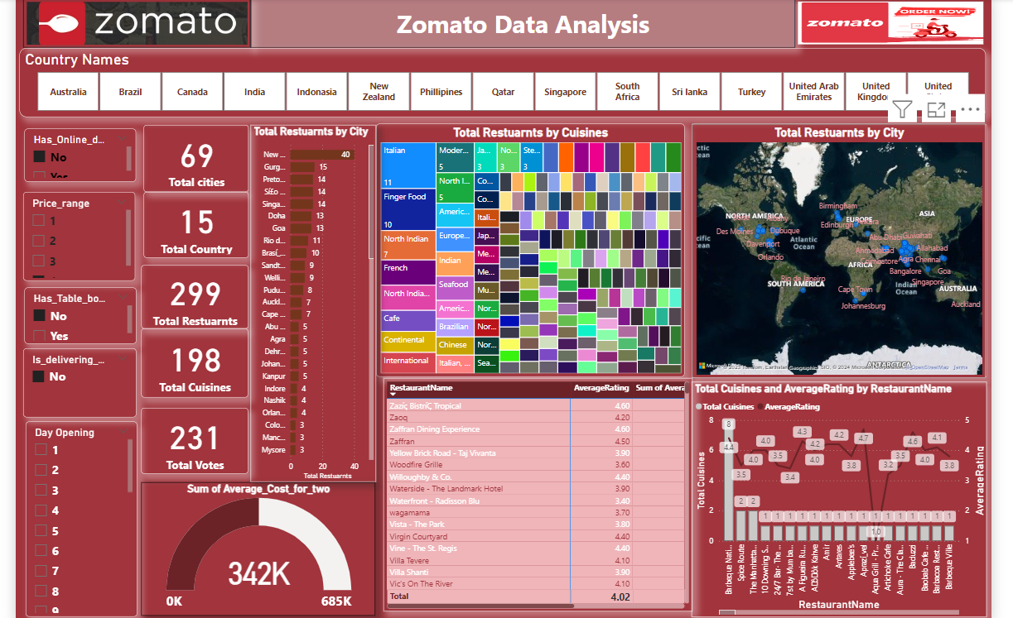
POWER BI DASHBOARD

Slide 9

STRATERGY FOR THE COMPANY
1. Customer Sentiment Analysis:
- Utilize natural language processing (NLP) techniques to analyze customer reviews and sentiments. Identify common themes, positive feedback, and areas for improvement.
2. Restaurant Rating and Performance:
- Evaluate the performance of restaurants based on ratings. Identify high-performing restaurants for potential partnerships or promotions.
3. Cuisine Popularity and Trends:
-Analyze the popularity of different cuisines and identity emerging food trends. This information can guide menu planning and marketing strategies .

Slide 10
4. Promotions and Discounts Effectiveness:
- Assess the impact of promotions and discounts on customer engagement. Identify successful promotional strategies and optimize future campaigns.
5. Competitive Analysis:
- Conduct a competitive analysis to understand the strengths and weaknesses of competing restaurants. Identify opportunities to differentiate and improve offerings.
6. Seasonal Variations and Events:
- Analyze customer behavior during different seasons and events. Plan marketing campaigns and menu promotions based on seasonal preferences.

Slide 11
THE END

